Slide 1

Training LLMs to Ask the Right Clinical Question
A data generation and fine-tuning pipeline for targeted clinical inquiry
LLLM Course
BIU
Avi Yosovich , Ori Maimon

Slide 2

The Challenge: Incomplete Clinical Data
Problem Context
Clinicians frequently work with partial patient information during early diagnosis. The ability to ask targeted, high-value questions can dramatically improve diagnostic accuracy.
Core objective: Train a small language model to generate clinically relevant questions from incomplete medical summaries that lead to better pathogen identification.

Slide 3

Task Definition
Partial medical summary x
~50% of patient data
Generate Clinical Question
Output clinical question q
Model D processes x
Focused, diagnostic question
Contextual understanding step
Given a partial medical summary x (containing ~50% of available information), generate a focused clinical question q that, when answered, significantly improves diagnostic accuracy for bloodstream infection pathogen identification.

Slide 4

Four-Model Architecture Pipeline
Model A
Model B
Model C
Generates partial summary x
Generates question q from x
Classifies pathogens, computes rank
Model D
Fine-tuned to generate q* from x

Slide 5
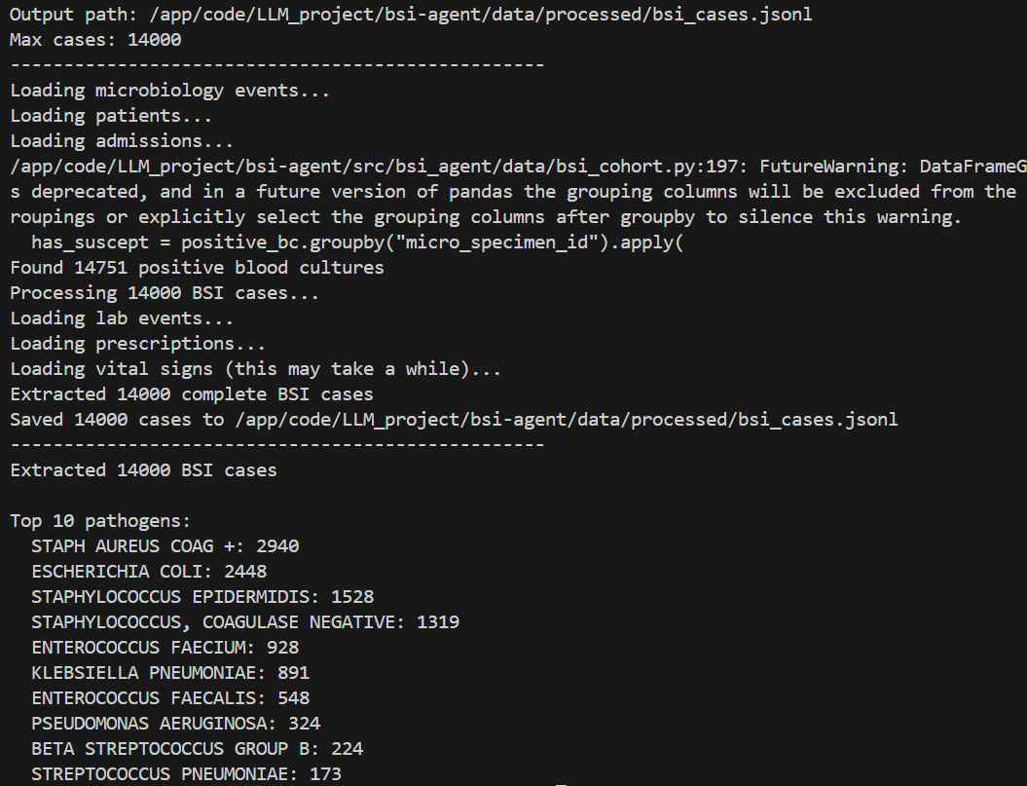
Data Source: MIMIC-IV
Bloodstream Infection Cases
We extracted 14,000 bloodstream infection cases from MIMIC-IV raw_data, focusing on real clinical encounters with confirmed pathogens.
Each case includes comprehensive clinical data: lab results, vital signs, medications, culture results, and temporal progression of the infection.

Slide 6
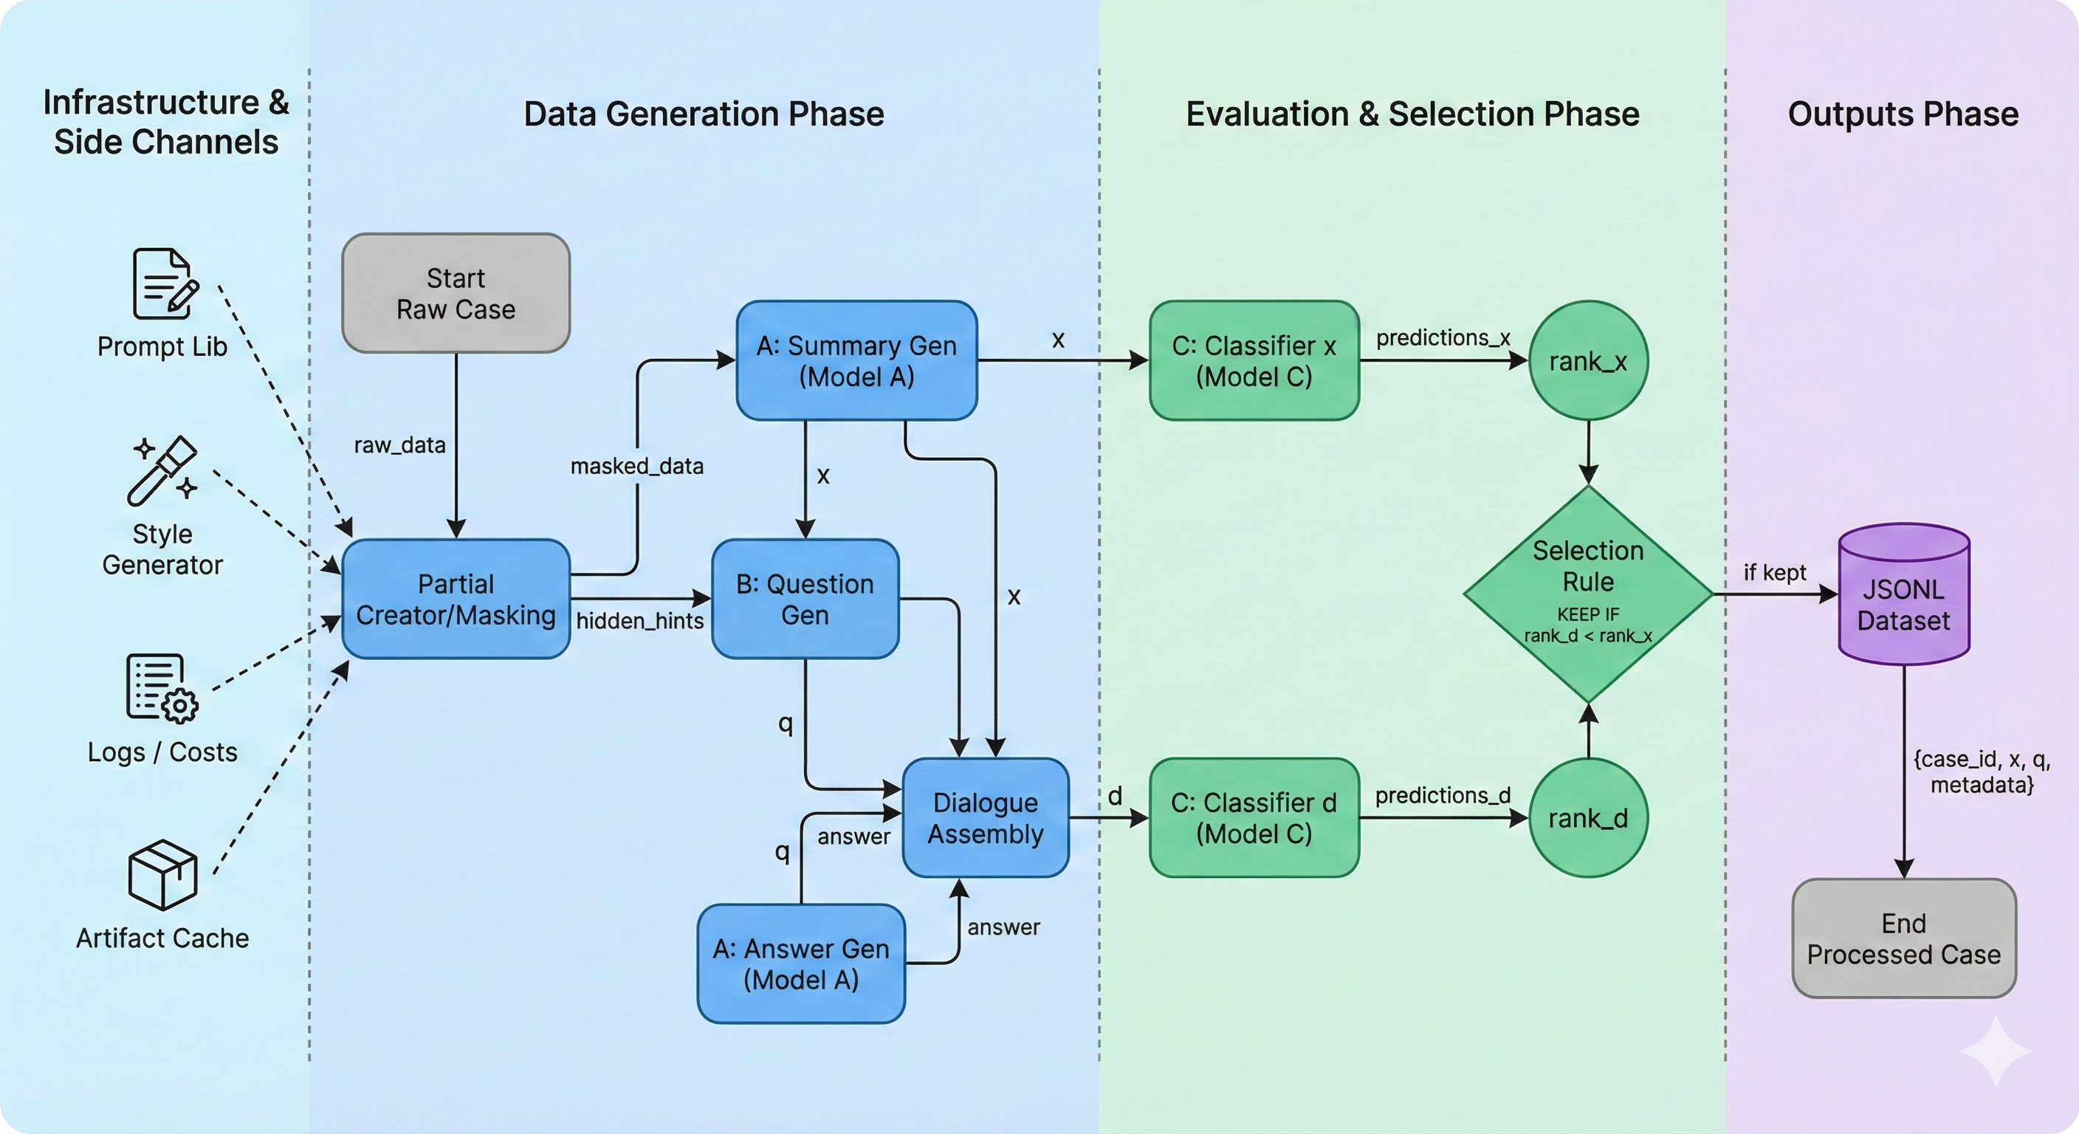
Data Generation Pipeline scheme

Slide 7
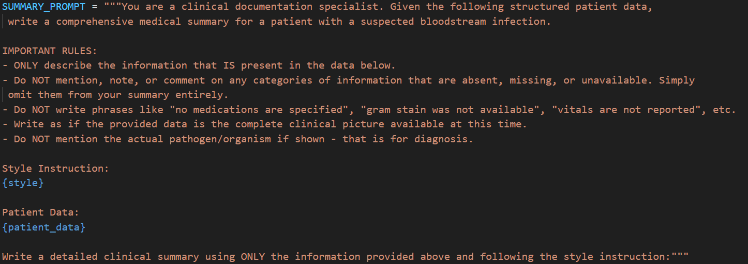
Sanity Check: Validating Model C
Testing on Full Information
Before using Model C to label "good questions," we validated its pathogen identification capability on 100 full medical summaries (100% information visible).
Success criterion: Model C must achieve strong Top-3 pathogen prediction accuracy to be trusted as the quality evaluator for questions.

Slide 8
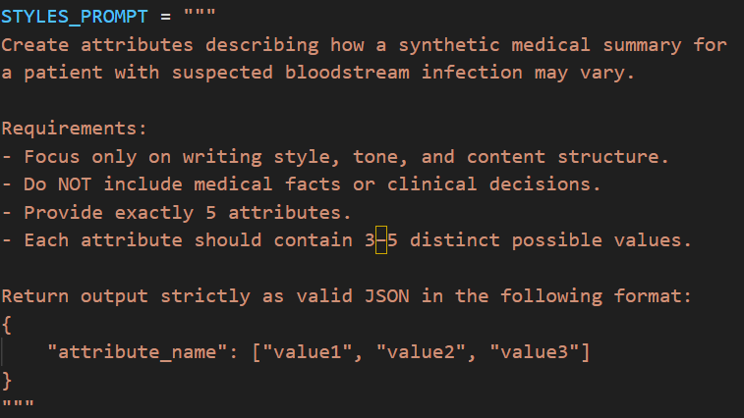
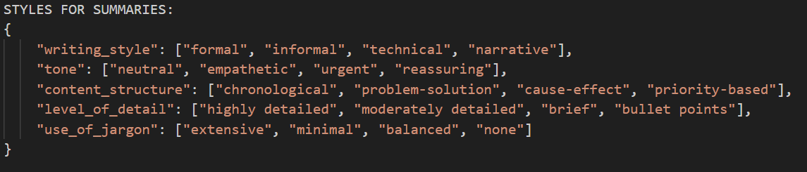
StylesGenerator for Questions
Diverse Question Styles
Question generation also employs style variation to create diverse training data:
Direct lab value requests vs. trend inquiries
Specific timepoint questions vs. temporal pattern queries
Single parameter focus vs. multi-parameter relationships
Open-ended vs. closed-ended question formats

Slide 9
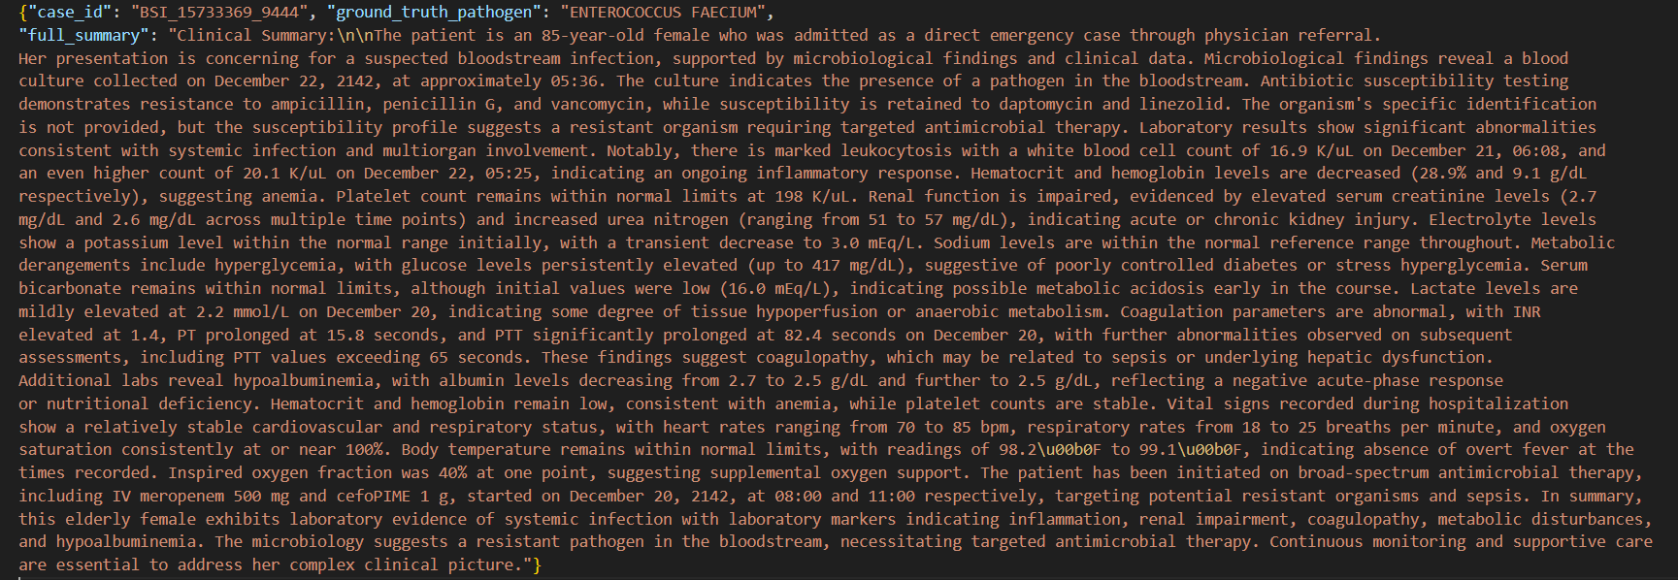
Full case example

Slide 10
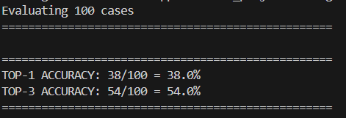
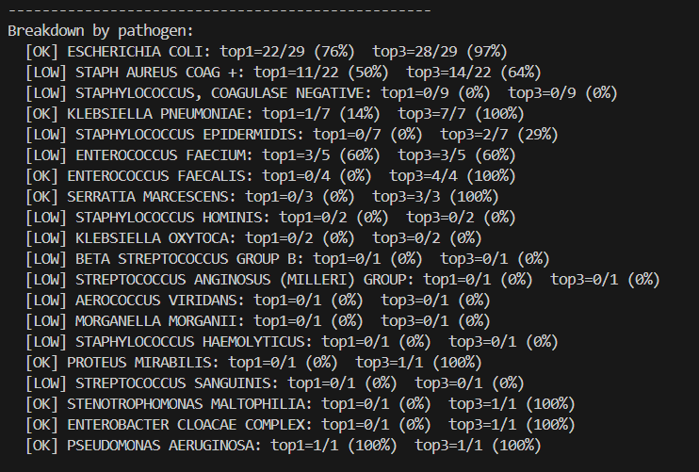
Sanity Check Results
Model C demonstrated good pathogen identification performance on the 100 full summaries, achieving reliable Top-3 accuracy. This validated our use of rank-based improvement as the criterion for labeling "good questions."

Slide 11
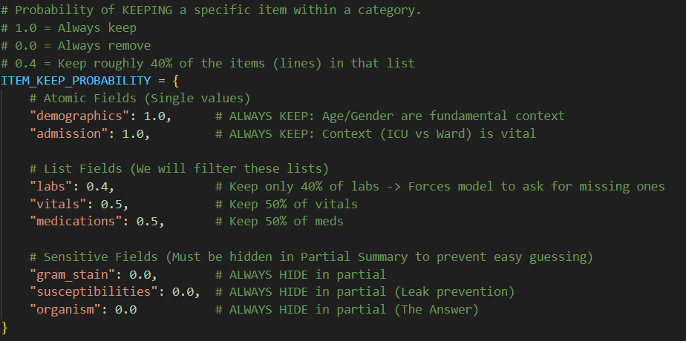
Creating Partial Summaries
Controlled Information Hiding
For each case, we randomly hide a percentage of the raw clinical data before generating the partial summary x.
The initial A/B data generation step exposes approximately 50% of the most important information, creating realistic diagnostic scenarios.
Model A receives the filtered raw data and a randomly selected summary style, then generates the partial summary x that represents the incomplete clinical picture available to the model.

Slide 12
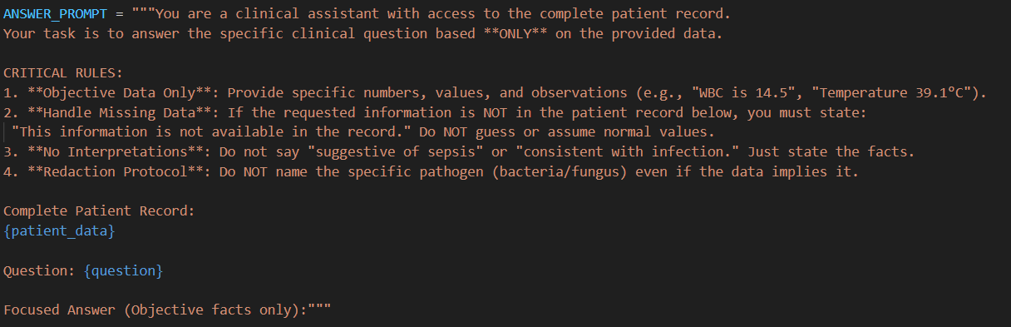
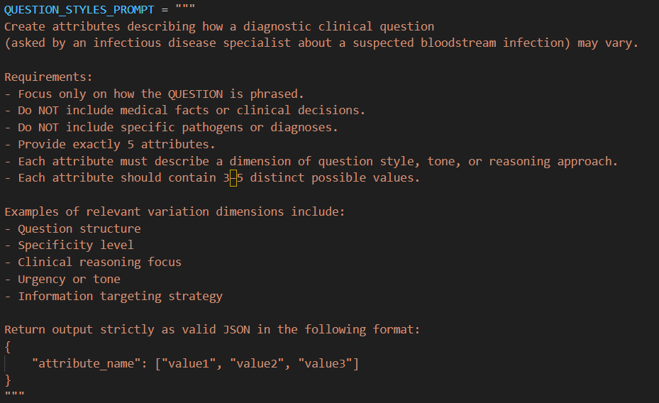
Question Generation Strategy
Focused Inquiry
Generate exactly one targeted question per case that addresses the most critical information gap
Strategic Hints
Provide hints about missing information categories to guide question relevance without revealing specific values
No Data Leakage
Questions must be answerable only from the hidden data, ensuring genuine information gain

Slide 13
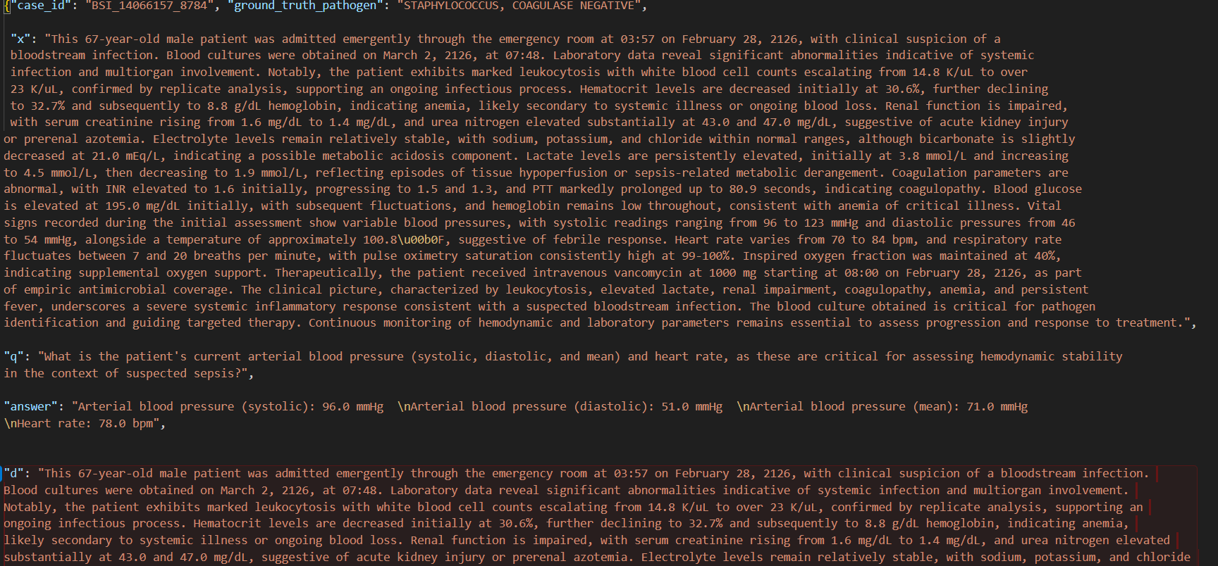
Answer Generation and Dialogue Assembly
Building Complete Dialogues
Model B generates the answer using the full raw clinical data (not just the partial summary), simulating access to complete patient records.
We then assemble the dialogue string: d = x + q + answer

Slide 14

Model C: Pathogen Classification
01
02
Rank Definition
Dual Evaluation
Model C predicts a ranked list of likely pathogens. Rank = position of ground-truth pathogen (rank 1 = best).
Run Model C on partial summary x alone, then on full dialogue d, computing rank for each.
03
Quality Criterion
Question q is "good" if rank improves when using d compared to x.

Slide 15





"Good Question" Selection Rule
Discard Pair
Omit from training data
Save Pair
Store [x,q] as good question
Rank Improved?
Does new rank beat baseline?
Compare Ranks
Compute rank using x vs d
By comparing Model C's pathogen identification rank before and after the question-answer exchange, we automatically identify which questions provide genuine diagnostic value. Only these [x,q] pairs enter the training dataset.

Slide 16
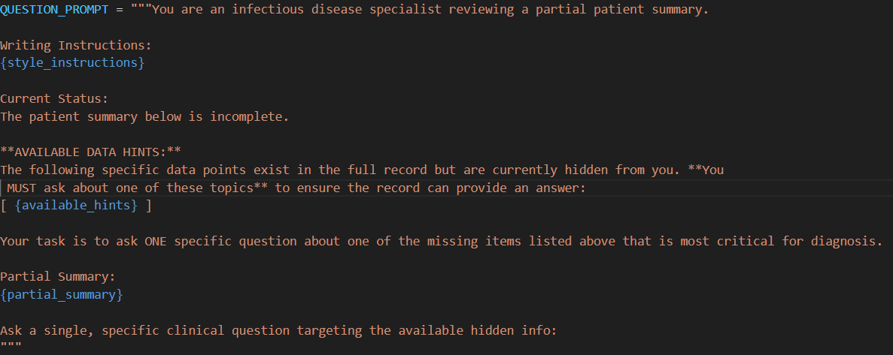
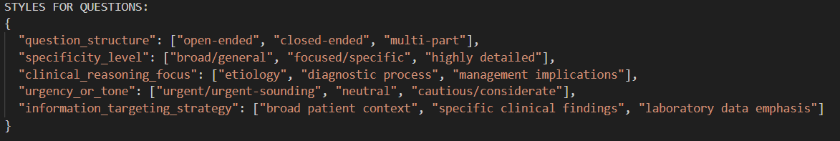
"Good Question" Selection prompt
We gave hints on the missing data so the model will ask only about data we have in the mimic dataset
We also added styles to the questions :

Slide 17
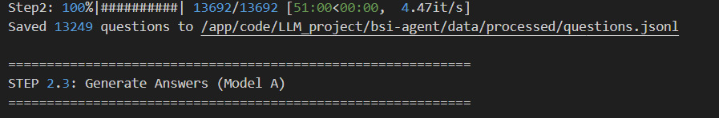
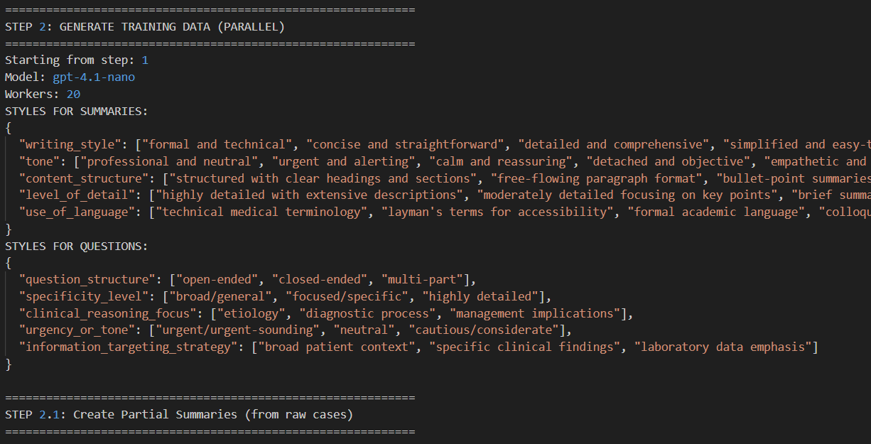
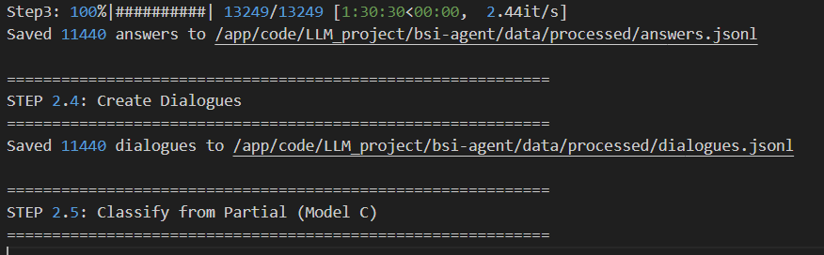
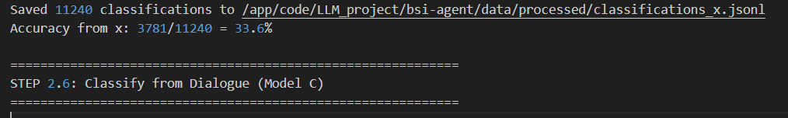
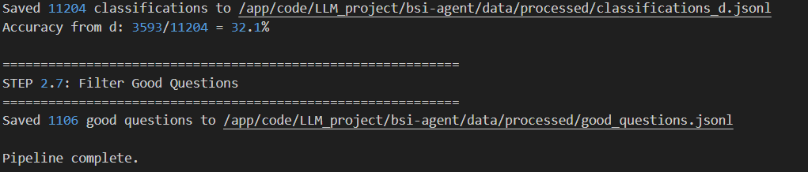
Full scale pipeline
We now ran the pipeline on all the cases
We got 1106 good questions that we saved in jsonl format with the [x,q] pairs

Slide 18

Pipeline Execution at Scale
Generation Results
14K
1106
$8
Total Cases
Good Questions
Total Cost
Processed from MIMIC-IV
Using gpt-4.1-nano
Saved to JSONL dataset

Slide 19

Fine-Tuning Model D
Base Model
Efficiency
Infrastructure
Mistral-7B from HuggingFace
4-bit quantization, LoRA-rank16 adapter
Trained on NVIDIA L40 GPU
Tokenization
Set -100 for instruction tokens

Slide 20
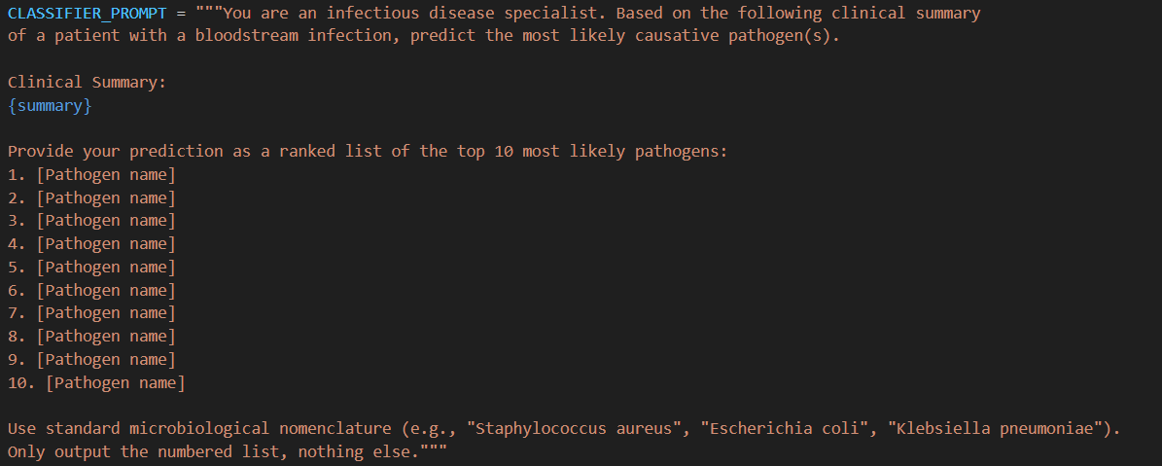
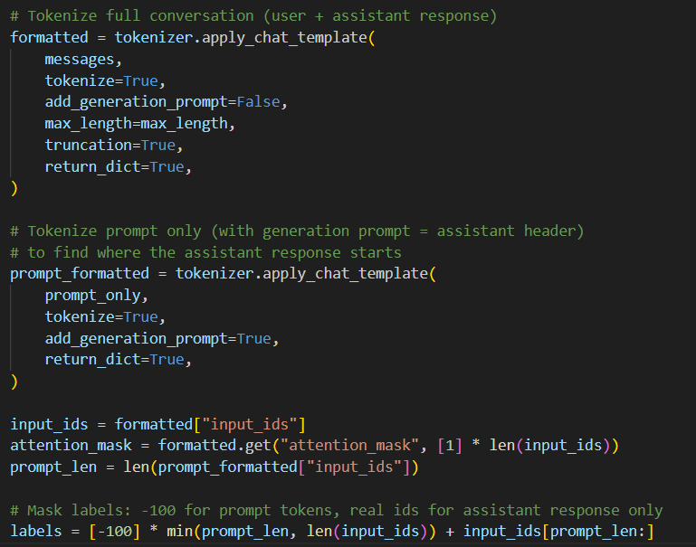
Fine-Tuning Model D
Input formatting includes a dedicated header with instructions prepended to each partial summary x, ensuring the model understands its task context.

Slide 21
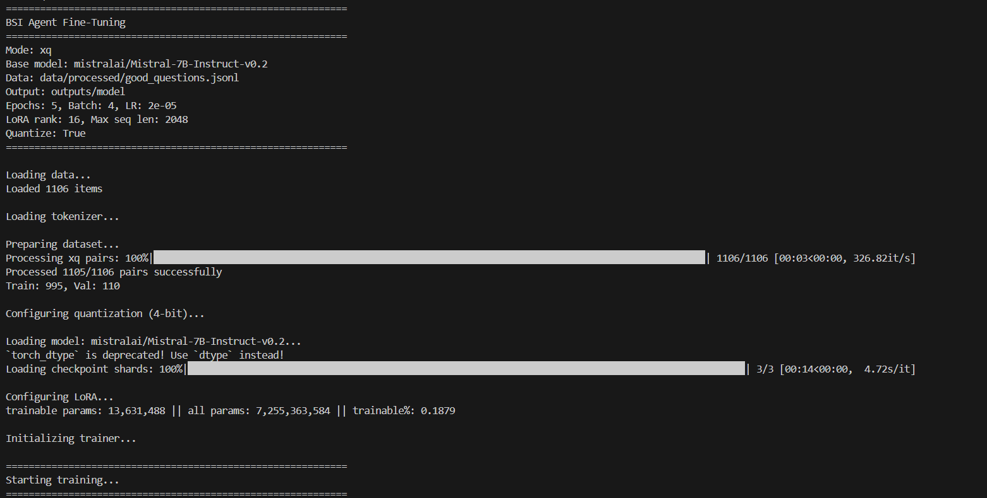
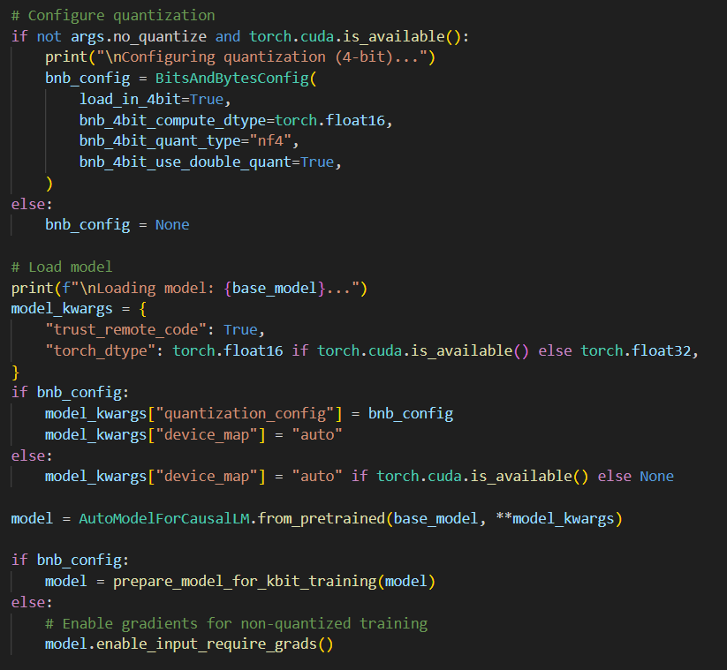
Fine-Tuning Model D

Slide 22
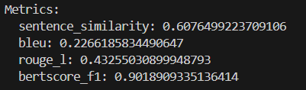
Evaluation Metrics and Performance
Test Configuration
90/10 train-test split yielding 110 evaluation pairs [q, q*] where q* is the model-generated question from test set partial summary x.
Sentence Similarity: Semantic alignment between q and q*
BLEU: N-gram precision overlap
ROUGE-L: Longest common subsequence F1
BERTScore F1: Contextual embedding similarity

Slide 23
Evaluation Metrics and Performance
We can see we got a good score for sentence similarity, and we can understand from that that the model generated meaningful questions.
The belu and rouge scores are low, but that is expected because we dont generate the same words in the questions.
The most relevant score is the bertscore_f1, and we have good accuracy of 90% - so the generated questions are similar to the good questions from the pipeline

Slide 24
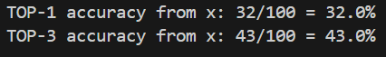
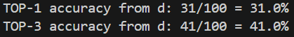
Use Cases
We examined 5 use cases for the fine tuned model.
Pathogen prediction. We gave the expert model the partial summaries and the model output the top 3 pathogens
The results are expected from partial summaries
2. We insert the partial summaries, the model ask question, we answer and the model predict the top 3 pathogens using the full conversation.
The results are worse than the answer without the questions, so we understand that we need to teach the model which questions to ask

Slide 25
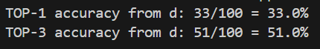
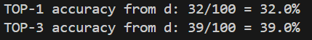
Use Cases
3. We insert the partial summaries into a small model ( a nurse model ), and the model asks a question, and the expert model answers it and then makes a top 3 pathogen prediction using all the dialogue.
The results are better than those obtained with the expert model asking the questions.
4. We insert the partial summaries into a small model ( a nurse model ) after a fine tuning , and the model asks a question, and the expert model answers it and then makes a top 3 pathogen prediction using all the dialogue.
We can see the fine tuning hurt the performance, maybe because of the small amount of data

Slide 26
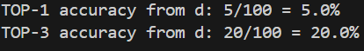
Use Cases
5. We insert the partial summaries into a small model ( a nurse model ) after a fine tuning , and the model asks a question, and the nurse model answers it and then makes a top 3 pathogen prediction using all the dialogue.

Slide 27
Use Cases
We can see that the best combination is an expert model for pathogen prediction combined with a nurse model for question generation.
Each expert model is around 800 input tokens and 165 output tokens – 0.029 cents.

